Slide 1
Input/Output
Last Time
Major Ideas and Concepts
Characteristics of I/O Devices
I/O Modules
Programmed I/O
Interrupts
Direct Memory Access
CPU-Memory-I/O Architectures

Slide 2
Last Time
The concept, operation and interactions of CPU registers
The operation of memory, roles of the memory address register and memory data register
The fetch-execute cycle - the simple movement and addition of data between registers
The relationship between the Little Man in the Little Man Computer and the steps in a fetch-execute cycle

Slide 3
Last Time
The bus concept, the various types of buses and the signals that make up buses
The purposes for which buses are used within a computer system
The concept of a bus protocol

Slide 4
Major Ideas and Concepts
CPU can act only upon instructions and data that are available in primary memory or in registers within the CPU and the impact of this requirement on I/O operations
Differences between character or byte-based I/O and block I/O and the characteristics of the I/O devices that would produce each
Concept and method of operation of direct memory access (DMA)

Slide 5
Major Ideas and Concepts
Purpose of interrupts, the various uses for interrupts, prioritization of interrupts
Effects of interrupts on program flow
Use of I/O modules and device controllers to control I/O operations
Bus and channel I/O system architectures

Slide 6
Characteristics of I/O Devices
I/O devices can either read, write or both
I/O devices operate at different speeds and all are significantly slower than the CPU
I/O devices have different format requirements – piece, block or stream
Multiple I/O devices can request services at the same time

Slide 7
Characteristics of I/O Devices
There are more I/O devices than CPUs
There needs to be a way to address individual I/O devices
There needs be a way for I/O devices to initiate communications with the CPU
There needs be a way to handle devices with extremely different control requirements

Slide 8
I/O Modules
I/O module is hardware that connects an I/O device to a pair of I/O registers in the CPU via a bus
I/O module serves as the interface between the CPU and a specific I/O device
Sometimes referred to as a device controller or control unit
I/O module accepts and sends messages to both the CPU and the I/O device
Creates a bridge that compensates for the speed and format differences between an I/O device and the CPU

Slide 9
I/O Modules
Offloads specific I/O tasks
Frees up the CPU to perform additional work
CPU doesn’t wait for the much slower I/O operations
Multiple I/O modules allow for multiple I/O devices to be used simultaneously
I/O module allows hardware designers to keep the CPU architecture much simpler

Slide 10
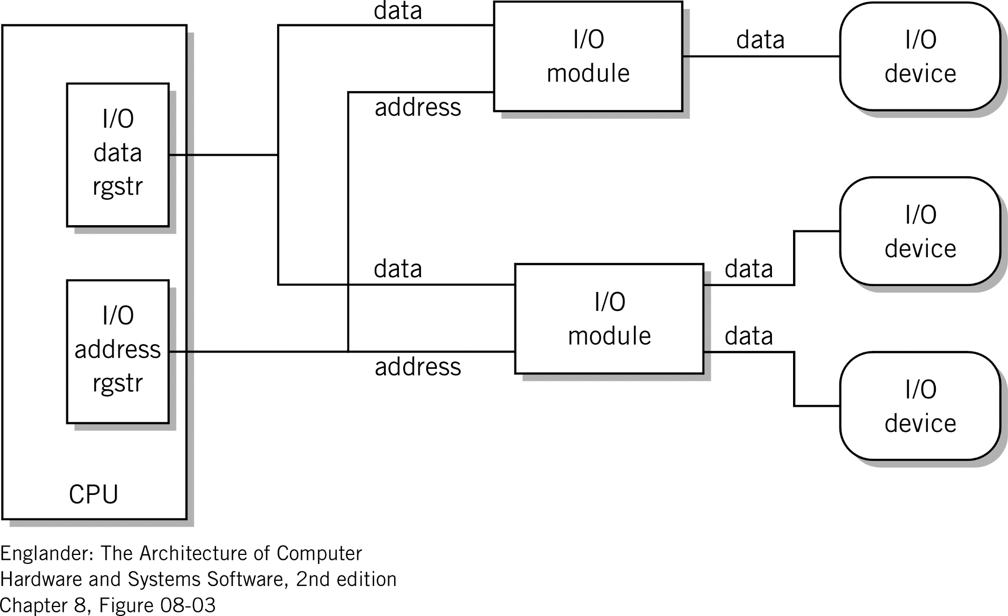
I/O Module Relationship

Slide 11
Programmed I/O
Simple method for performing I/O
Uses I/O registers
  I/O Data Register
  I/O Address Register
  Serve same role as input and output baskets in the Little Man computer
Data is moved from I/O device to I/O module to I/O data register
Moved one word at a time
Moved to accumulator register under program control

Slide 12
Interrupts
Reasons for altering the program’s normal flow
Range from:
  Unexpected command from external device
  Abnormal situation like a power failure or execution of an illegal instruction
  Completion of an I/O task
Need a way to allow the computer to take some special action
Specific purpose of an interrupt, allow handling of unique situations
Allow multiple activities to take place at the same time

Slide 13
Interrupts
Special control lines call Interrupt Lines
Commonly referred to as Interrupt Requests or IRQs
Presence of a message on one of these lines causes the CPU to suspend the program being executed
Transfers control to the special interrupt-processing program called an interrupt handler or interrupt routine
Process of handling the interrupt is known as “servicing the interrupt.”
Interrupt handler saves and restores the contents of all registers before and after processing the interrupt
Interrupted program resumes execution exactly where it left off

Slide 14
Interrupts
Normally seven interrupt classes
Vary by hardware manufacturer
Processed priority sequence
Hardware – unrecoverable errors
Software – intended requests
Illegal use of instructions
Hardware – recoverable errors
External interrupts – operator intervention
Input/Output – requests for external data
Restart – Manual restart or requests from other CPUs

Slide 15
Direct Memory Access
Impractical to move large quantities of data using Programmed I/O
Even using interrupts
Data from disk and tape drives is transferred in blocks
Doesn’t make sense to execute a separate instruction for each piece of data in a block
Block data may, in some cases, contain hundreds or thousands of records
This is a sticky problem … how do you solve it?

Slide 16
Direct Memory Access
Computer manufacturers, provided the capability to move blocks of data directly between the I/O module and memory
Data movement process is under the control of the I/O module
Program in the CPU, using programmed I/O, initiates the data transfer
CPU is bypassed for the remainder of the transfer
I/O module notifies the CPU via interrupt when the transfer is complete
Known as Direct Memory Access or DMA

Slide 17
Direct Memory Access
DMA needs three conditions to be met:
Method to connect the I/O module and memory – usually a bus
I/O module must be capable of reading from or writing to memory
  That is, must be able to load a MAR and read and write to the MDR – it’s own or other
Means of avoiding a conflict between CPU and I/O module
  Only specific memory addresses can be used by one I/O device at a time
  Each device needs its own memory area (buffer)

Slide 18
CPU-Memory-I/O Architectures
Various ways of interconnecting hardware
Two commonly used I/O architectures
  Bus architecture - used mostly by personal computer and workstation manufacturers
  Channel architecture - used primarily in IBM mainframe computers

Slide 19
CPU-Memory-I/O Architectures
Bus Architecture provides for the interconnection with other buses through bus interfaces
Uses CPU instructions to initiate data transfers between I/O module and memory
Buses are usually shared with other components
Ability to interconnect buses provides two key capabilities
Design and use of industry standard buses from different vendor’s equipment
  Makes it possible to use I/O devices from multiple vendors
  Provides ability to interconnect buses
  Provides future flexibility; as bus designs evolve new bus interfaces can be implemented

Slide 20
CPU-Memory-I/O Architectures
Channel Architecture is based on a separate I/O processor known as a channel subsystem
I/O processor acts as a separate computer just for I/O operations
Freeing up the CPU to for other tasks
Divides the I/O task into two pieces
  Controls the I/O operation
  Controls specific devices

Slide 21
CPU-Memory-I/O Architectures
Channel subsystem is made up of sub-channels
Each one is connected through a control unit module to an individual I/O device by one or more channel paths
Design allows for multiple channel paths between the channel subsystem and the control unit
If a path is busy another can be selected
Various control units and I/O devices are still connected to the CPU by a bus

Slide 22
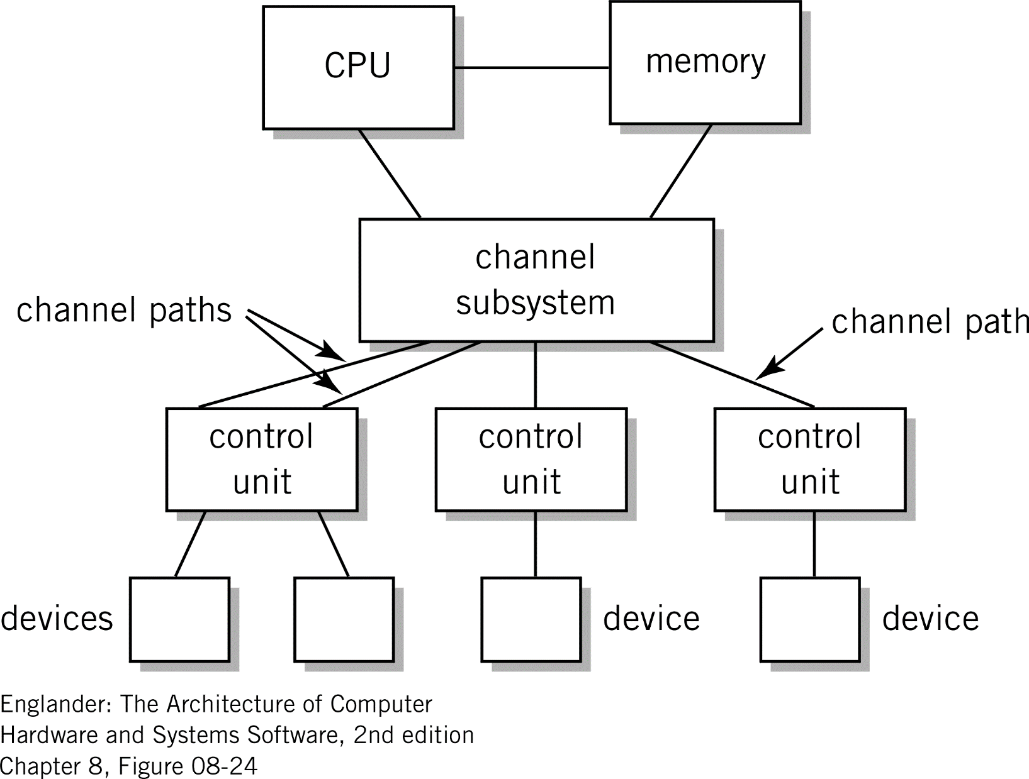
Figure 8.24 I/O Channel Architecture

Slide 23
Summary
Regardless of the architecture, bus vs. channel
Very important to offload specific I/O tasks to separate devices - like the I/O module
Free up the CPU to perform additional work
CPU doesn’t wait for the much slower I/O operations
Multiple I/O modules allow for multiple I/O devices to be used simultaneously
Modular approach allows hardware designers to keep the CPU architecture much simpler

